Slide 1
Customer
Churn Risk Prediction
By Muhamad Fikri Mumtaz

Slide 2
Presentation Outline
01
Introduction
02
Data Analyst
03
Prediction Modeling
04
Result and Conclusion

Slide 3
01
Introduction

Slide 4

Background Problem
Fast n Quick Company is an online trading company that has been established since 2007 and is currently the top 5 online trading company in Indonesia.
However, several reports say that they have lost some of their customers in the period of 2015 - 2018.
They want to minimize the risk of customers stopping using the services and products they offer.
They hired me to find out why some customers stopped using their company's products.

Slide 5

Problem Statement
Predicting customers who will Churn using Deep Learning ANN

Slide 6
02
Data Analyst

Slide 7
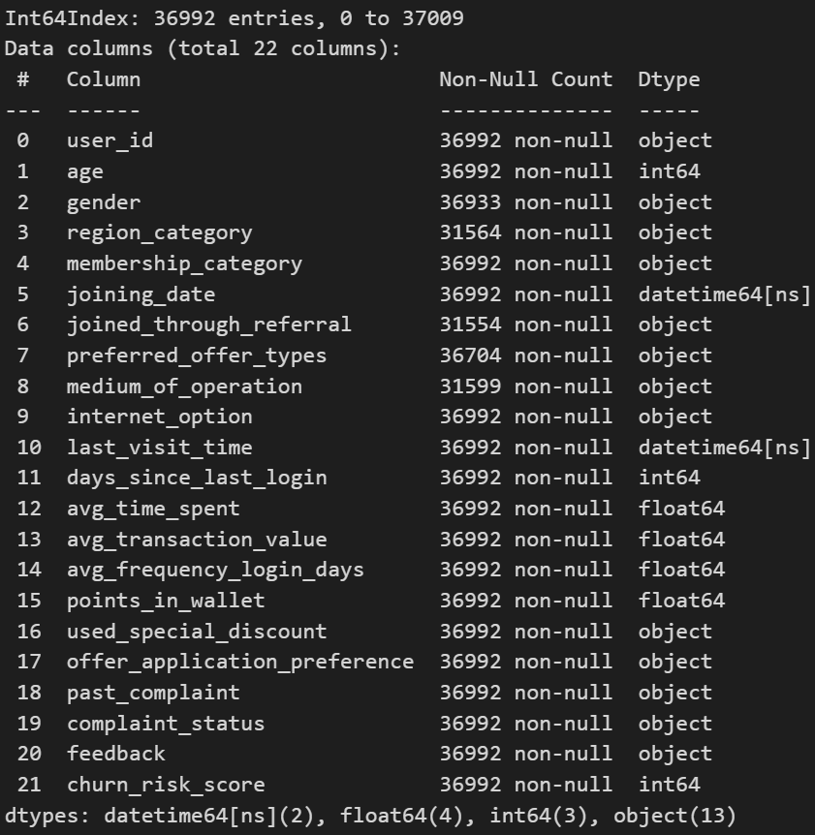
Dataset Overview
There are 36992 Data in our Dataset
Our data are splits between Object, Integral, Float, and Datetime.
We are using 17 variable to predict churn risk
Variable are split into categorical, and numerical columns.

Slide 8
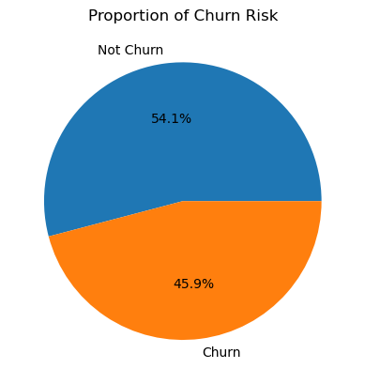
Churn Risk Proportion
As shown in the plot that 54.1% users are not churn it means that majority of users are not churn.
However, there are 45.9% of users that are churn or stops using company services and products means that there are major problem in the services or products that needs to be fixed.

Slide 9
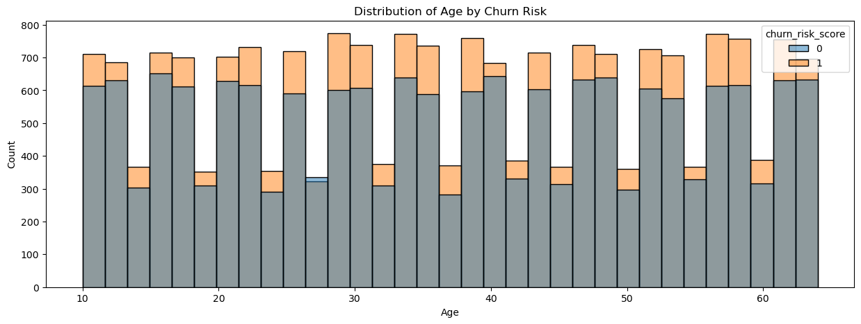
Age Distribution
As shown in the plot that all of users that using the company product and services are in all range of ages that span between 10 to 65 years old.
Almost all users in all range of ages have churn.

Slide 10
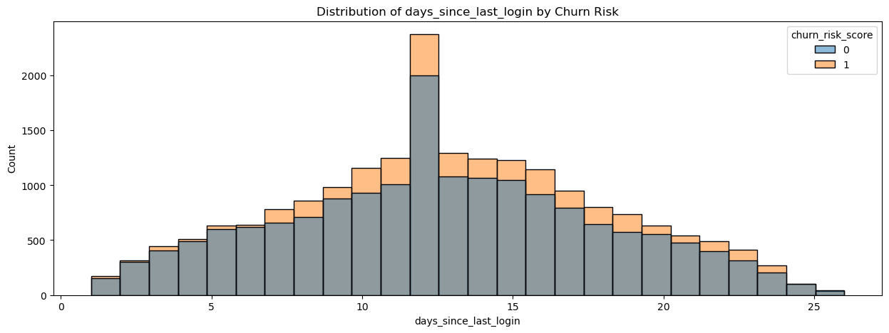
Inactive Period Distribution
As shown in the plot that users has an average of 12 days of inactive periods between online period.

Slide 11
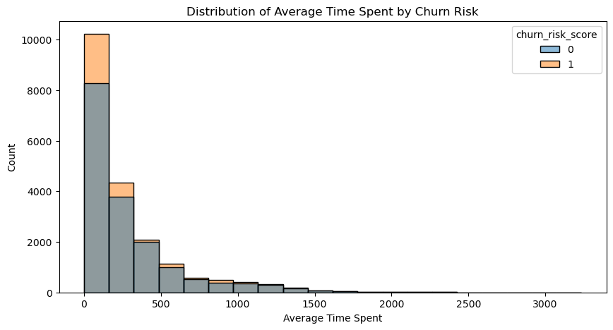
Time Spent Distribution
As shown in the plot that users has an average of 279 seconds of time spent using the company services and product.

Slide 12
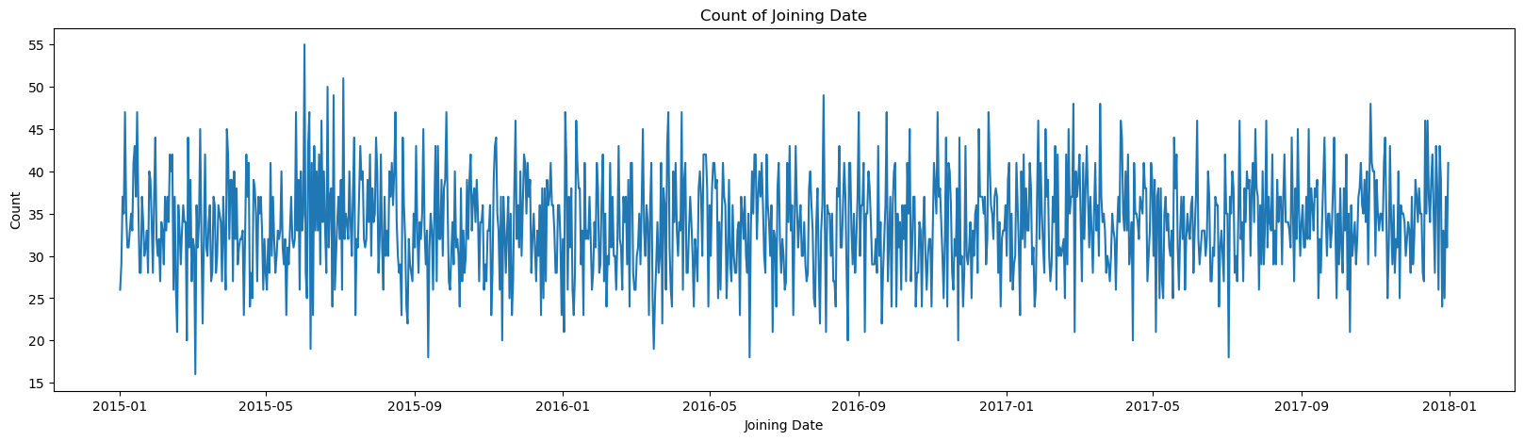
Average Transaction Distribution
As shown in the plot that we have an average of 35 users that joining the services and products each day.

Slide 13
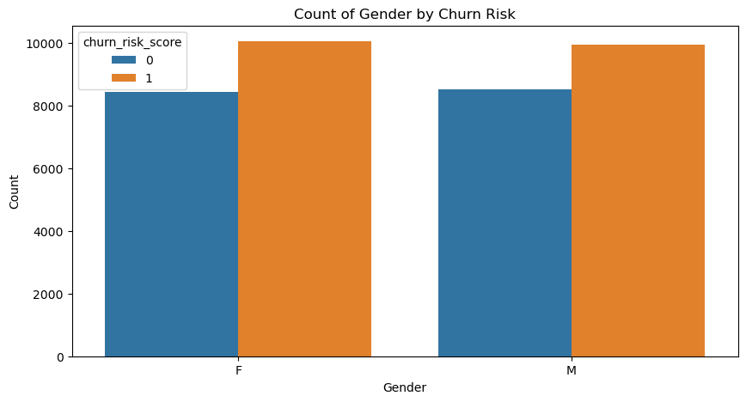
Gender Distribution
As shown in the plot that there aren’t any differences in gender for churn customer.

Slide 14
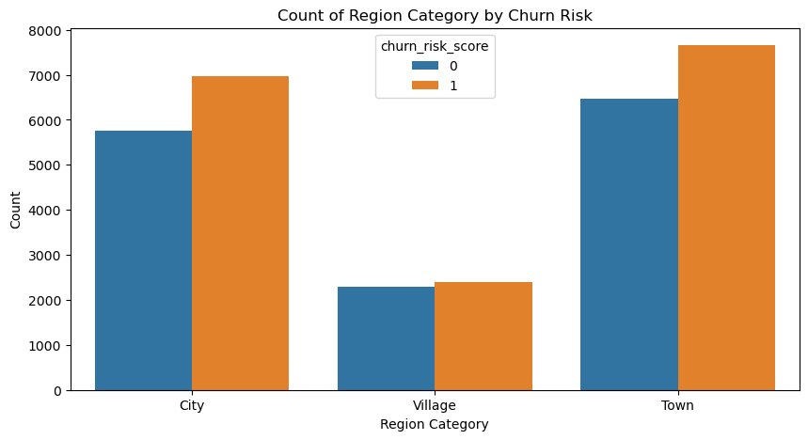
Region Distribution
Surprisingly that Town region having much more customer than in the city region and thus more churned customer.

Slide 15
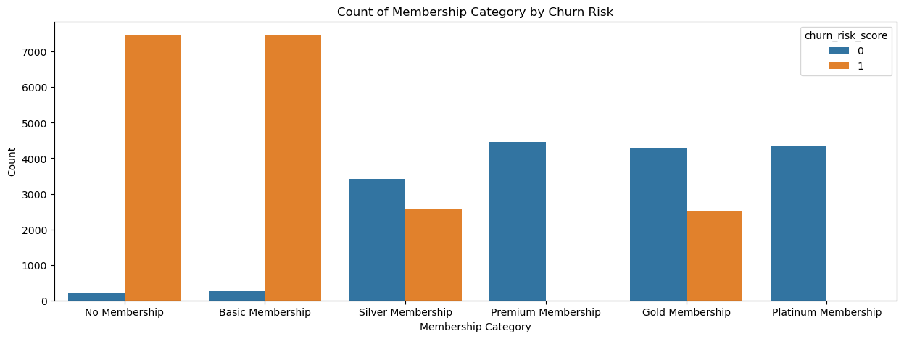
Membership Distribution
Membership segmentation gives a clear differentiation for every users and thus each users membership have a different behavior.

Slide 16
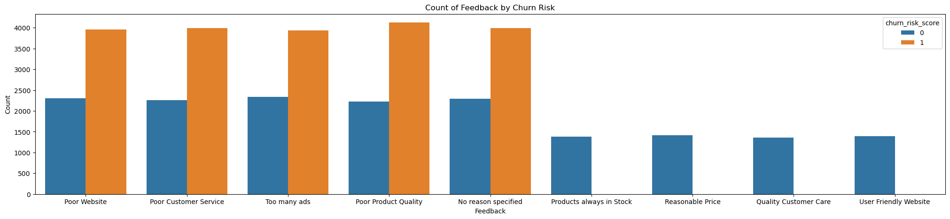
Feedback Distribution
Feedback are differentiated by 2 kind that is positive and negative feedback.
Negative feedback are mostly by churned customers.

Slide 17
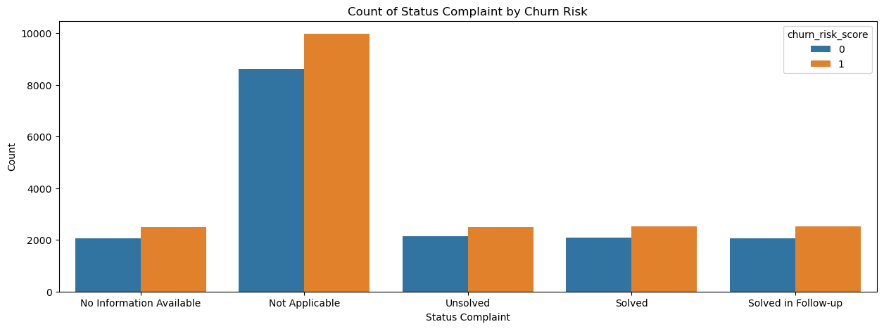
Status Complaint Distribution
Many users has a complaint to the company as complain are part of customer interaction.
However many complaint are not applicable maybe because the complain are ridiculous or absurd.

Slide 18
03
Prediction Modelling

Slide 19
17 Columns in dataset
Churn Risk Score
Feature
Target

Slide 20
Modeling Run Timeline
Model Evaluation
04
Scaling and Encodings
02
05
Model Saving and Inference
Model Training and Hyper Parameter
03
Split data between Train, Validation, and Test Data
01

Slide 21
Modeling Sequence
ANN Sequential
ANN Sequential with Hyper Parameter
ANN Functional with Hyper Parameter
ANN Functional

Slide 22
Result and Conclusion
04

Slide 23
Train Model Accuracy
Model Sequential Improvement
Model Sequential Training
72%
93.5%
With Relu Activation in 3 hidden layer, Sigmoid in output layer, using Nadam optimizers with 0.01 learning rate.
With default parameter
01
02
03
04
Model Functional Improvement
Model Functional Training
85%
93.7%
With Selu Activation in 3 hidden layer with batch normalization, and Sigmoid in output layer, Adamax for optimizers with 0.01 learning rate.
With default parameter, using 3 hidden layer with batch normalization

Slide 24
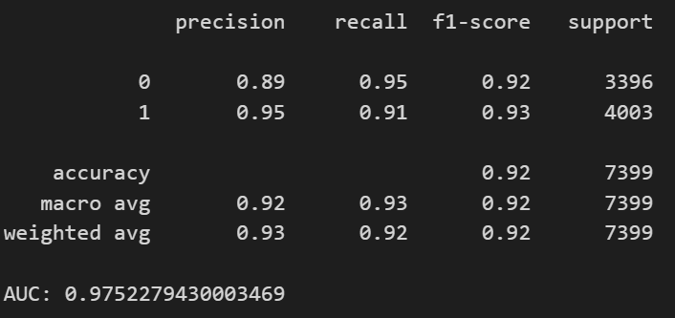
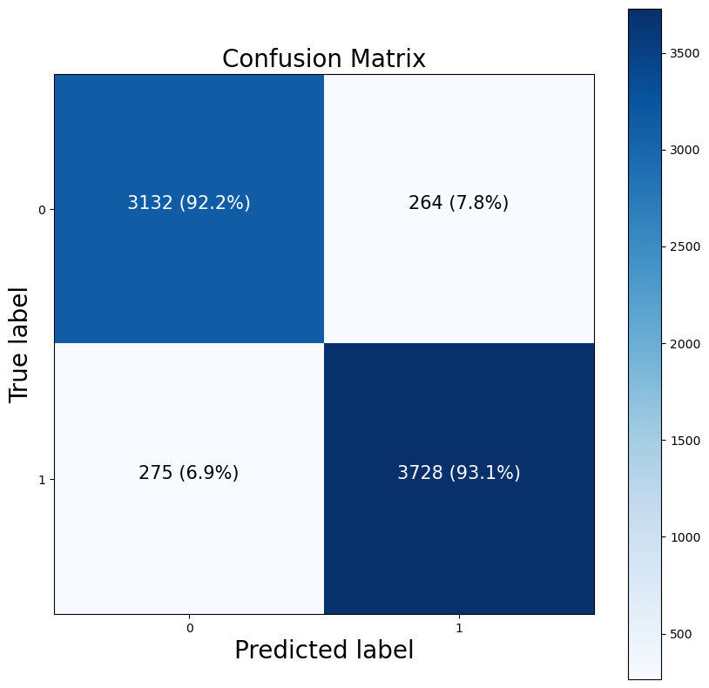
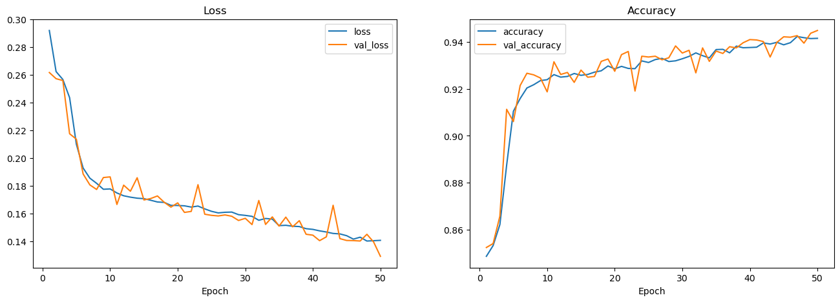
Best Model Evaluation
Model Functional Improvement
Best Model with 97% Accuracy in train model with 10.111 params.
93% Accuracy in Test Model.
Good Accuracy despite with imbalance data.

Slide 25
Model Result and Conclusion
In the Sequential API, it is found that models that do not perform hyperparameter tuning or in the default state, are found to be quite good but overfit, as is the case with the Functional API which is found to be good but overfit.
After doing Hyperparameter Tuning using several parameters such as Epoch, Learning rate, Optimizer, and Activation on the hidden layer and adding a hidden layer, it managed to increase the accuracy of the model very significantly.
After doing Hyperparameter Tuning, the best model was obtained, namely model_3 are Functional Improvement Model API with an accuracy value of 93% in the test data.

Slide 26
Business Result and Conclusion
In conclusion, the reason why many customers stop using the company's services and products is because according to them the products offered are of low quality, the website has too many ads, the customer service is not of high quality and so on.
therefore I recommend immediately improving the quality of the website, customer service and products offered and if possible to introduce new products to customers.

Slide 27
Thank You
By Muhamad Fikri Mumtaz

